Slide 1
Prediction-based Autopilot Interface for Drone to Object Chasing using Historical TSPI Data
Team. Beer per Day
Shinhyoung Jang, Byeonghwi Park, Juheon Jeong (Chungnam National University)
Jack Mahedy, Nebey Gebreslassie (Purdue University)
Notes:
Hello, I’m byeonghwi from the team Beer per day.
Today I’ll talk about the prediction based autopilot interface / for drone to object chasing / using historical TSPI Data

Slide 2
Contents
Introduction
Methodology
Experiment
Demo
Conclusion
Notes:
These are our contents of presentation

Slide 3
INTRODUCTION
TEAM, ACRONYM, MOTIVATION & PROJECT GOAL
Notes:
First part, Introduction.

Slide 4





Introduction
Team Introduction
Shinhyoung Jang
Computer Science & Engr.
Chungnam Nat’l Univ.
Team Leader
Byeonghwi Park
Computer Science & Engr.
Chungnam Nat’l Univ.
Research & Developer
Juheon Jeong
Computer Science & Engr.
Chungnam Nat’l Univ.
Research & Verifier
Jack Mahedy
Computer & Information Tech.
Purdue Univ.
Research & Developer
Nebey Gebreslaassie
Computer & Information Tech.
Purdue Univ.
Research & Verifier
Notes:
These are our team members.
Shinhyoung, Juheon and I, are in computer science and Engr. at CNU.
Jack and nebey are in CNIT department at purdue.

Slide 5
Introduction
Acronym
UAV: Unmanned Aerial Vehicles
TSPI: Time Space Position Information
ML: Machine Learning
Coordinate: the set of Latitude, Longitude, and Altitude
Trajectory: drone’s flying path
MAPE: Mean Absolute Percentage Error
Notes:
Before the presenatation, I explain the acronym.
The UAV means unmanned aerial Vehicles, and the TSPI is Time space Postion information.
The other acronyms are in this slide. (After 10s)

Slide 6
Introduction
Project Motivation
UAV has a variety of usages and is used in a multitude of settings such as military use
- In the 2022 Russian invasion of Ukraine, UAV takes part in and strikes other territories to destroy the installation^{[1]}
- In 2022 North Korean drone invasion of airspace in South Korea– North Korea, on January 3rd, 2023, North Korean UAV entered the no-fly zone, but South Korea didn’t detect it with their Radar systems^{[2]}
⇒ UAV and detecting UAV systems are becoming more important in the Military
[1] S. Rosenberg and J. Lukiv. “Ukraine war: Drone attack on Russian bomber base leaves three dead.” https://www.bbc.com/news/world-europe-64092183 (accessed Jan. 11, 2023).
[2] J. Kwon and S. Jeong, I. Kottasova and J. Yeung “South Korea fires warning shots after North Korean drones enter its airspace.” https://www.cnn.com/2022/12/26/asia/north-korean-drones-south-airspace-intl/index.html (accessed Jan. 11, 2023).
Notes:
Ok. This is our motivation.
The recent news shows that UAVs are used in Military such as R inv u and NK invasion in SK.
So we got insights that UAV is becoming more important in Military

Slide 7
Introduction
The Approach of Identifying Objects
2 way to detect object which is far from the camera
Ways | Pros | Cons
Using digital zoom | Low cost | Losing information
Using better camera lens | High accuracy | High cost
⇒ Making the distance from the camera to the target to be closer by chasing with drone.
This approach also provides the benefits that utilize combat like self-destructive
Notes:
For these reason, we focus on the object classification, and how to detect the object by camera.
There are 2 ways.
first one is using digital zoom the picture. It is low cost but it is possible to loss picture data.
next one is using better camera lens, it is high accuracy but high cost.
So, we suggested the making the distance from the camera to the target to be closer by chasing with drone.
This approach also provides the benefits that utilize combat like self-destructive

Slide 8
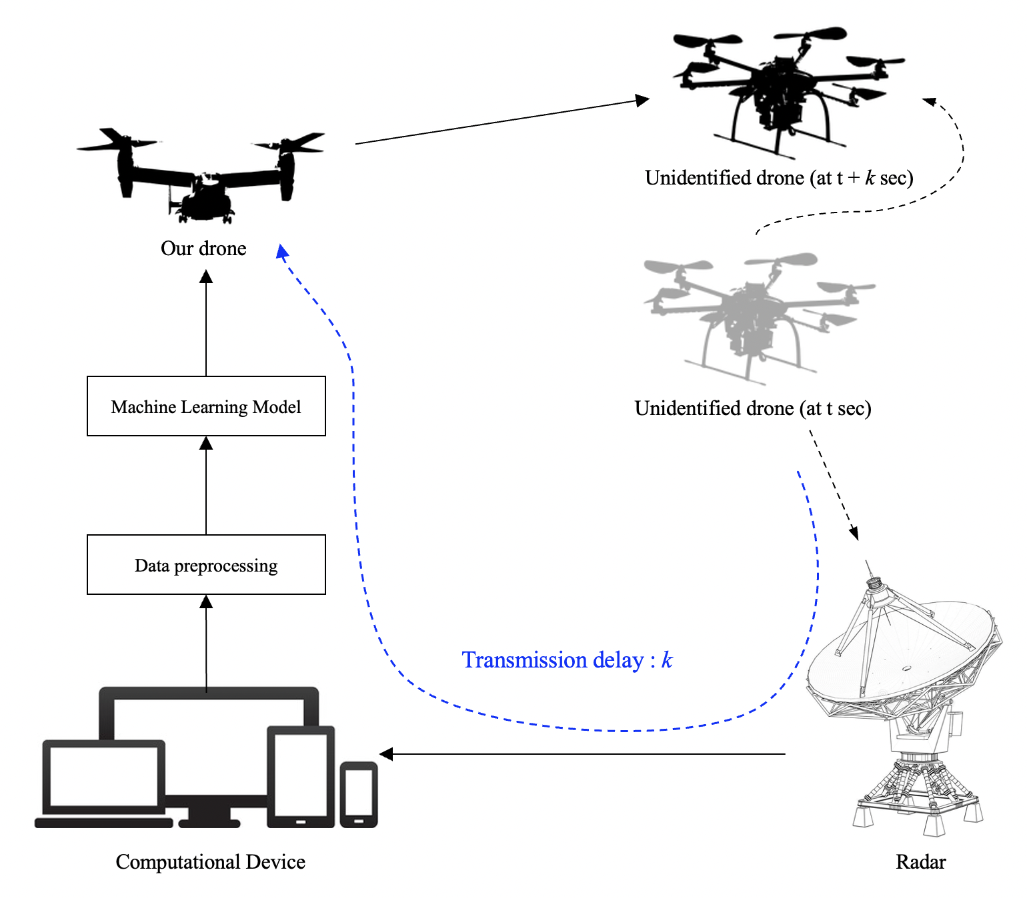
Introduction
Goal
Making Prediction Based Autopilot Interface for Drone to Object Chasing Using TSPI Data
Notes:
At the result, we suggest that making prediction based autopilot for drone to object chasing using TSPI data.

Slide 9
Introduction
Challenges
Improve to get close to the object (chasing algorithm)
- The data communication from drone to object detecting systems exists
→ latency k needs to be considered to get more accuracy with prediction
Prediction model of the drone’s location
- It needs systems for predicting the next position
→ It is possible to predict by using ML models with historical TSPI^{[3]-[5]}
The method that the drone goes to the location
→ System needs the Auto-pilot method
[3] Ziyu Zhao, et al. A Deep Learning Approach for Aircraft Trajectory Prediction in Pre-Tactical Stage, 2022 5th Int. Symp. on Autonomous Systems (ISAS)
[4] Xie Lei, et al. UCAV maneuvering trajectory prediction based on PSO-CNN, 2021 Int. Conf. on Computer Engineering and Application (ICCEA)
[5] Peng Shu et al. Trajectory prediction of UAV Based on LSTM, 2021 2nd Int. Conf. on Big Data & Artificial Intelligence & Software. Engineering (ICBASE)
Notes:
To achieve goal, we have to solve some challenges
first one is improving chasing algorithm
Because of data communication latency, so we have to predict the object’s coordinates for latency k
next, we have to figure out that possibility of applying ML model in trajectory.
The 3 related works said that it is possible to predict by using ML models with historical TSPI.
last, we need auto-pilot method

Slide 10
METHODOLOGY
DETECTING SYSTEM, MACHINE LEARNING MODELS
Notes:
Next is Methodology part.

Slide 11
Methodology
Flow chart
Radar detects an unidentified object and gets coordinate
Radar transmits data to the computer
Preprocess the dataset to fit ML models
S/W predicts the coordinate for latency k with ML models
Transmit data to our Drone
Notes:
I will explain the Flow chart in our presentation simply.
when the radar detects the object, it get the coordinates of object and send this data to computational device.
next, the device preprocess the data and apply the Machine Learning model to data.
the result of predication is transmitted to our drone.
the number 1 and 4 are most important parts in this process.

Slide 12
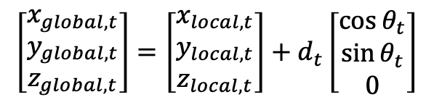
Methodology
Detecting System
Radar and Lidar System
- Getting the distance and angle from the system to the object by using radio signals or light
Converting the TSPI of the object by using Cartesian coordinates
- x, y, and z are equal to latitude, longitude, and altitude
- z value is not relative with Cartesian coordinates
- The equation shows the converting function
$$\left[\begin{matrix}x_{global,t} \\ y_{global,t} \\ z_{global,t}\end{matrix}\right]=\left[\begin{matrix}x_{local,t} \\ y_{local,t} \\ z_{local,t}\end{matrix}\right]+d_{t}\left[\begin{matrix}\cos{θ_{t}} \\ \sin{θ_{t}} \\ 0\end{matrix}\right]$$
(1)
Notes:
First is Detecting System
The typical detecting Systems are radar and Lidar.
they get the distance and angle from object.
the radar uses the radio signal and lidar uses the light.
But result is relative coordinates, so we have to convert this.
the equation 1 shows the converting process with the radar absolute position, distance and angle.

Slide 13
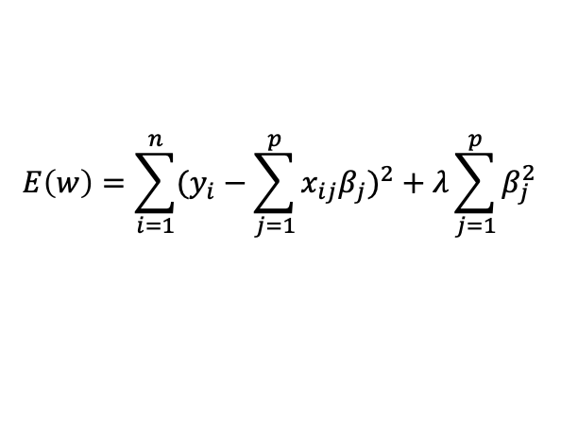
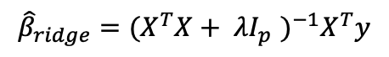
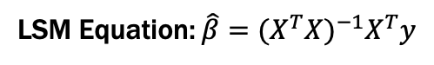
Methodology
Machine Learning Models – Linear Regression
Linear Regression reveals the relation (β) between input and output with a distribution of train data
It uses the equation $y=\hat{β}X$ to get $\hat{y}$, and $\hat{β}$ can be calculated by the Least Square Method
LSM Equation: $\hat{β}={(X^{T}X)}^{−1}X^{T}y$
(2)
As increasing the number of features leads to overfitting in the ML model, the Ridge Regression is suggested to reduce these problems
$${\hat{β}}_{ridge}={(X^{T}X+ λI_{p}^{})}^{−1}X^{T}y$$
(3)
$$E\left(w\right)=\sum_{i=1}^{n}{{(y_{i}−\sum_{j=1}^{p}{x_{ij}β_{j}})}^{2}}+λ\sum_{j=1}^{p}{β_{j}^{2}}$$
(4)
Notes:
Next is Machine Learning Models.
First one is Linear Regression
this model reveals the relation between input and output of dataset.
It uses the equation y equals beta hat X to get prediction. and this beta hat can be calculated by the Least Square Method.
But this model can’t decrease the overfitting in ML model.
So we suggests that the ridge regression to reduce these problems.

Slide 14
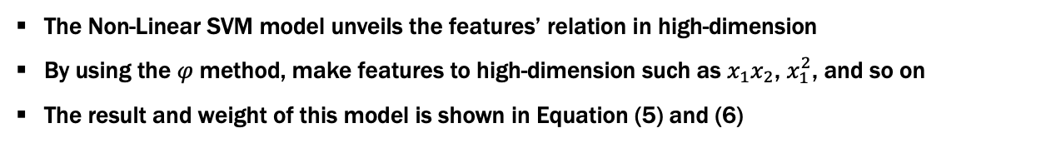
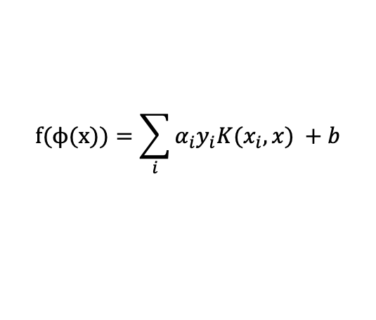
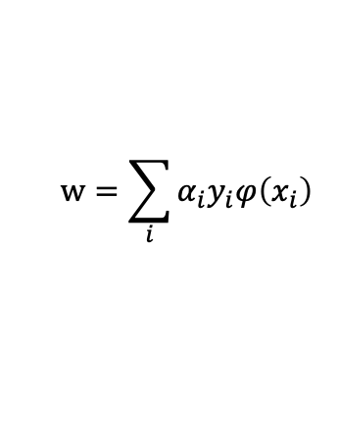
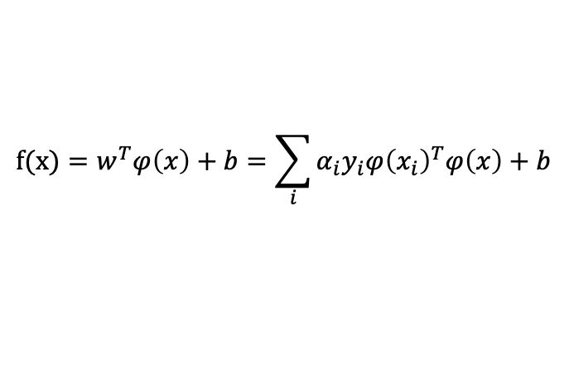
Methodology
Machine Learning Models – Non-Linear Soft Vector Machine Regression (Non-Linear SVM)
The Non-Linear SVM model unveils the features’ relation in high-dimension
By using the $φ$method, make features to high-dimension such as $x_{1}x_{2}$, $x_{1}^{2}$, and so on
The result and weight of this model is shown in Equation (5) and (6)
$$f(x)=w^{T}φ\left(x\right)+b=\sum_{i}{α_{i}y_{i}{φ\left(x_{i}\right)}^{T}φ\left(x\right)+b}$$
$$w=\sum_{i}{α_{i}y_{i}φ\left(x_{i}\right)}$$
(5)
(6)
The Equation (7) is induced by replacing the ${φ\left(x\right)}^{T}φ\left(x\right)$ to the kernel trick
$$f(ϕ(x))=\sum_{i}{α_{i}y_{i}K(x_{i},x) +b}$$
(7)
Notes:
second one is Non-Linear Regression model.
This model unveils the features relations like Linear Regression.
But, it is possible to expand to high-dimension plane.
The phi method helps to make feature to high-dimension such as x1 times x2, x1 square and so on.

Slide 15
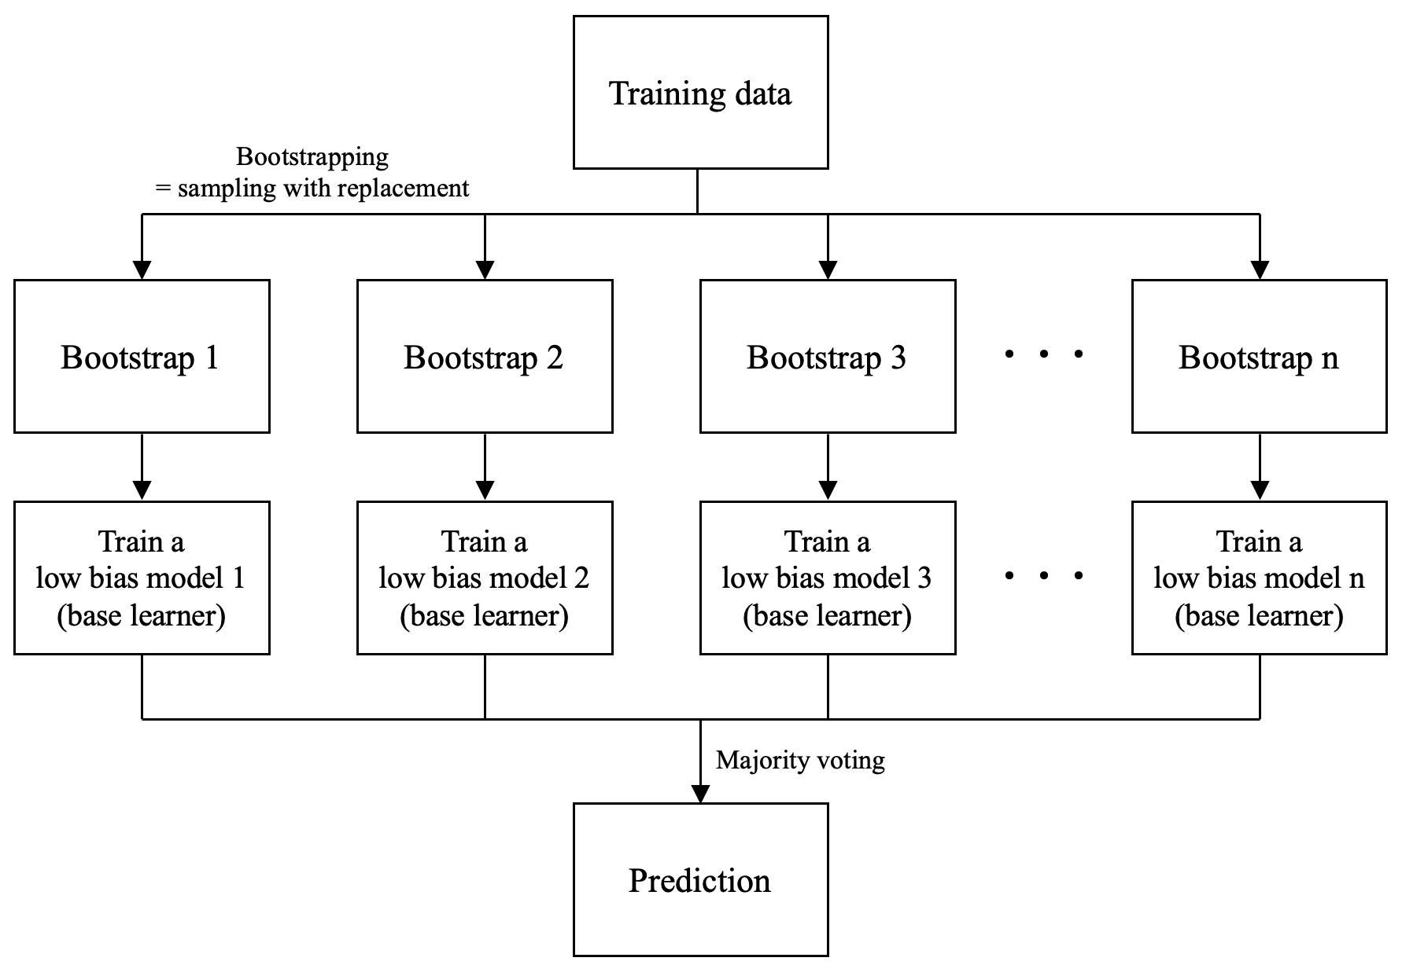
Methodology
Machine Learning Models – Ensemble Regression (Bagging Method)
The Ensemble model is based on the idea that models obtained a different perspective
The Bagging method uses 10–30 models that are low bias and high variance
It combines them into 1 result by using the majority voting, which is called ‘high variance cutting’
Notes:
The Last model is Ensemble Regression.
It use the high variance cutting and majority voting.
By using these, It is combining different models into 1 model.
Because of this reason, it can have various perspectives.
And next part is experiment part.
Shinhyoung will explain this.

Slide 16
EXPERIMENT
SYSTEM FLOW, VERIFY MODELS

Slide 17
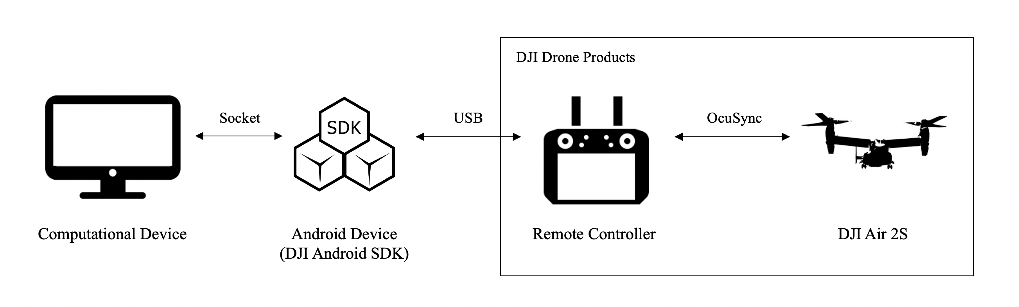
Experiment
System Architecture
In the experiment, verify the ML model prediction and autopilot method separately with an assumption of latency as k seconds (Assume that android receive the unidentified drone’s coordinate at intervals of k seconds)

Slide 18
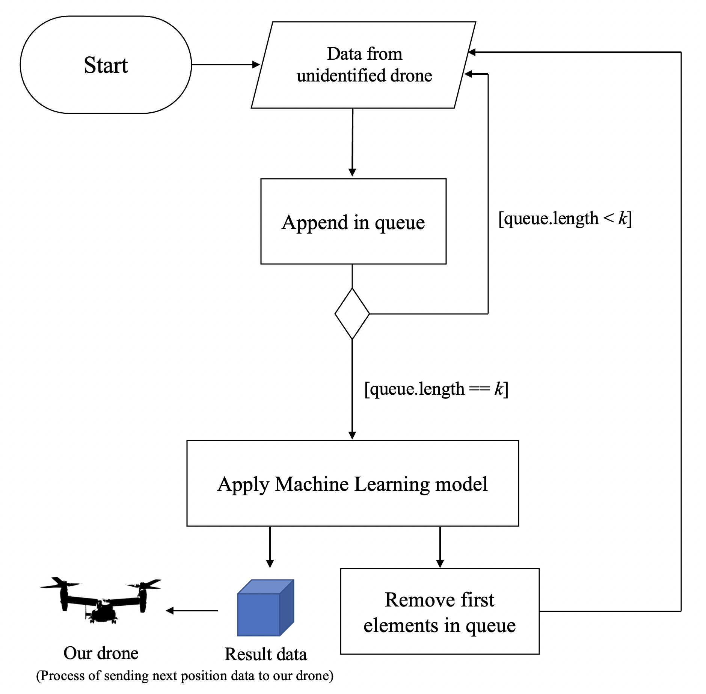
Experiment
Data Flow in Computer (ML model)
The detecting system sends the drone’s coordinates to the Android Device
The Android Device transmits the data and the computer saves the data in the queue
If the queue size is lower than k, go to process #1 else, go to process #4
Apply prediction to the queue and transmit the result to our drone
Remove first element in queue and go to process #1

Slide 19
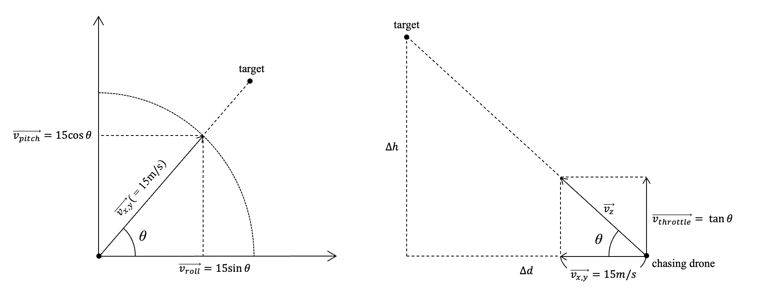
Experiment
Auto-Pilot Method
Some of DJI’s product contains a waypoint mission which is moving to a specific position, but it isn’t supported in DJI air 2S
It has a method that set up the speed such as pitch, roll, and throttle
In the DJI documents, pitch and roll speed is restricted by 15m/s and the other one, the throttle is restricted by 4m/s
Trigonometric function used to calculate the speed of the variable
Calculate latitude and longitude vector
Calculate altitude vector

Slide 20
Experiment
Data Collection
The data produced in the real world has various variables that don’t remain constant (wind, clouds, sunset, et cetera)
- To ensure uniformness of condition, the DJI simulator was used to create the dataset
There are 2 ways that moves the drone in the simulator
Touching by hand | User can build a customized flight path instantly
Drawing with a method | User doesn’t need to focus on changing every heading

Slide 21
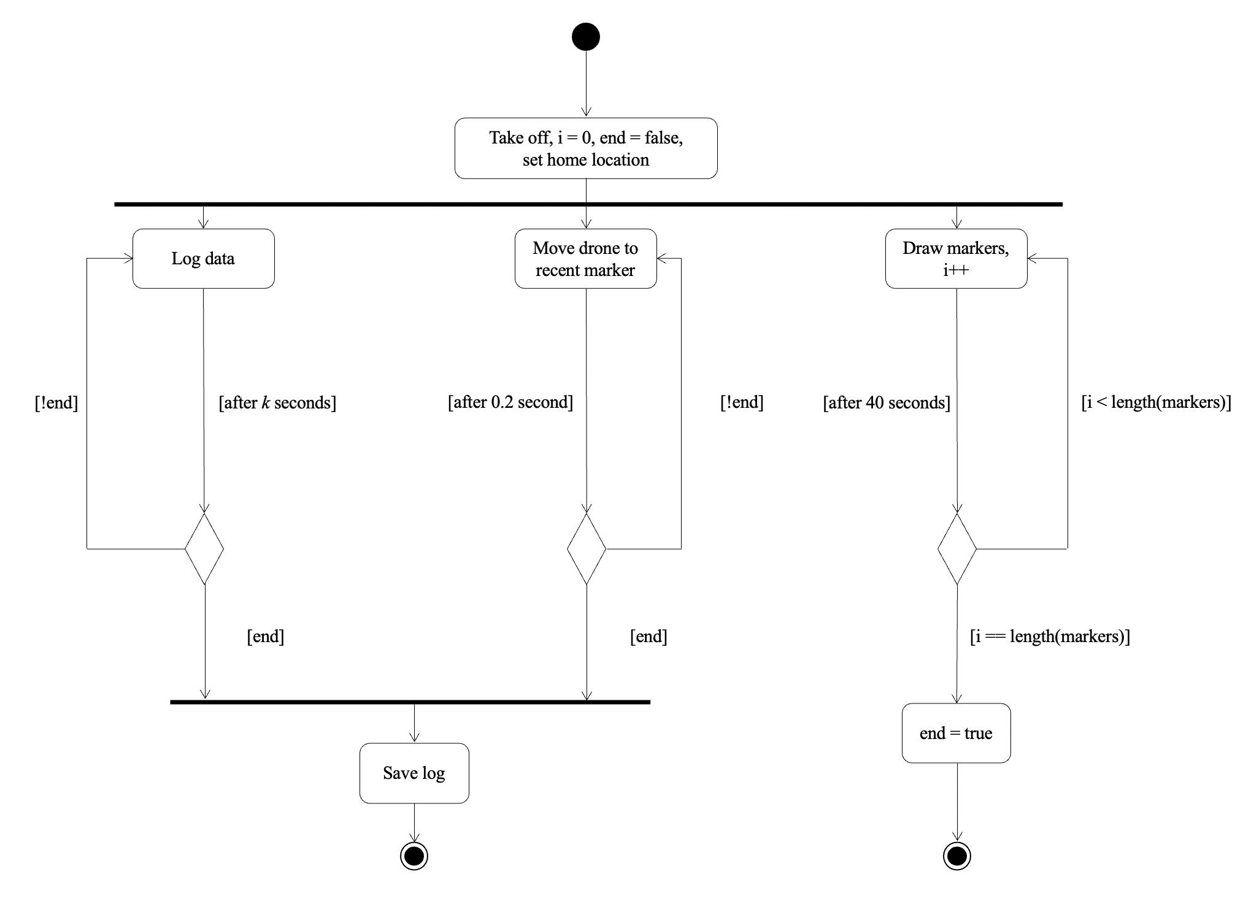
Experiment
Data Collection – Activity Diagram
At the start, set the initial value of the parameters
As this method has 3 asynchronous works, using the 3 threads at each interval
- Logging data, drawing markers, and moving drone
To make various dataset, the program initialize the pinpoints array (letter z shape, number 8 shape et cetera)

Slide 22
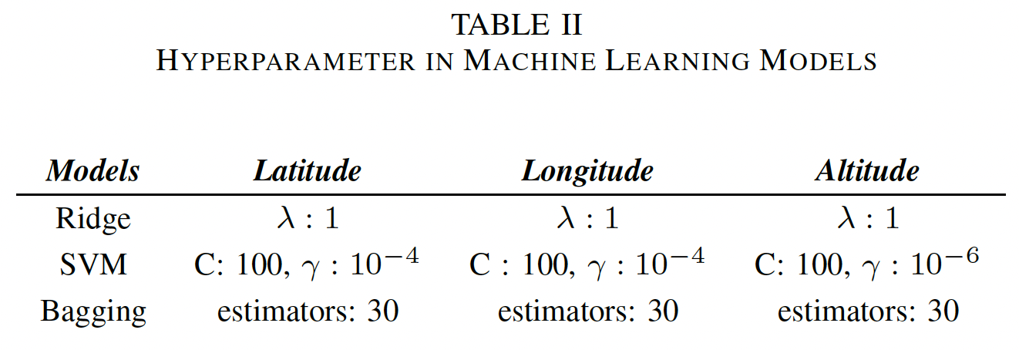
Experiment
Verify ML models
Since the performance depends on the hyperparameters, it needs to consider the latency k and the number of raw data t
ML model list: Linear Regression, Non-Linear SVM (RBF Kernel), and Ensemble (Bagging)
The gridSearchCV method, which results the best hyperparameter in the scikit learn module, is used in each variable to choose the hyperparameter

Slide 23
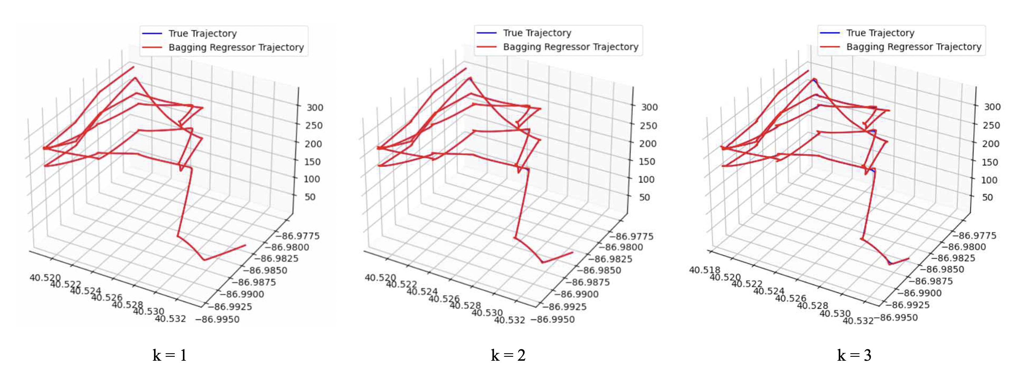
Experiment
Verify ML models (Cont’d)
The figure shows the Bagging Regression representatively
The trajectory prediction is good to follow the tendency of the drone’s move
In these regressions, the hyperparameter k as 1 is the best of them

Slide 24
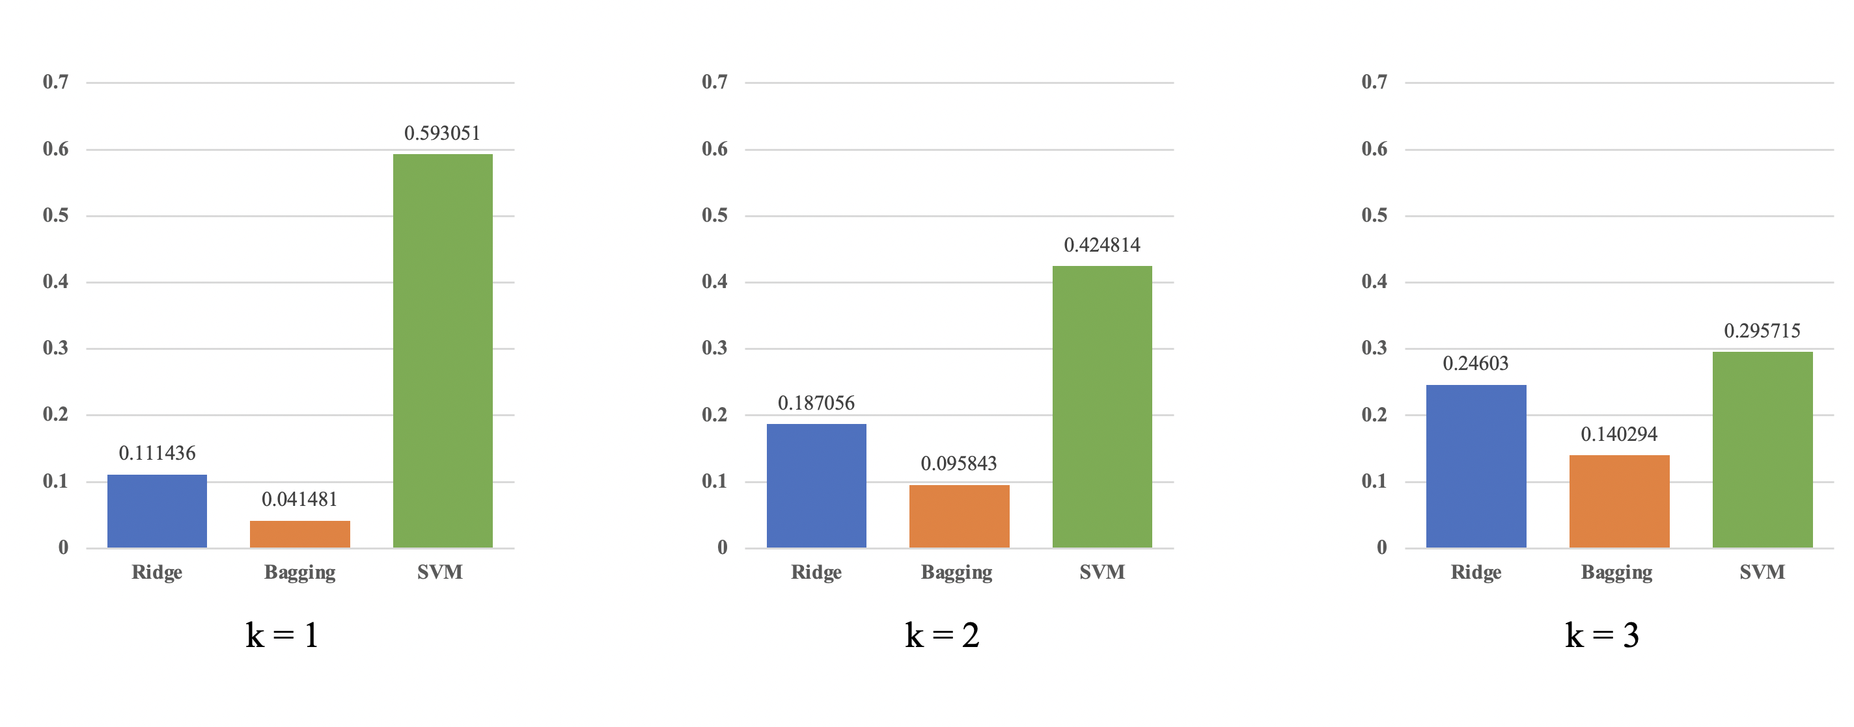
Experiment
Verify ML models (Cont’d)
According to the comparison of models, the Bagging Regression is the best model to predict among the models via MAPE

Slide 25
DEMO
PROJECT DEMO

Slide 26
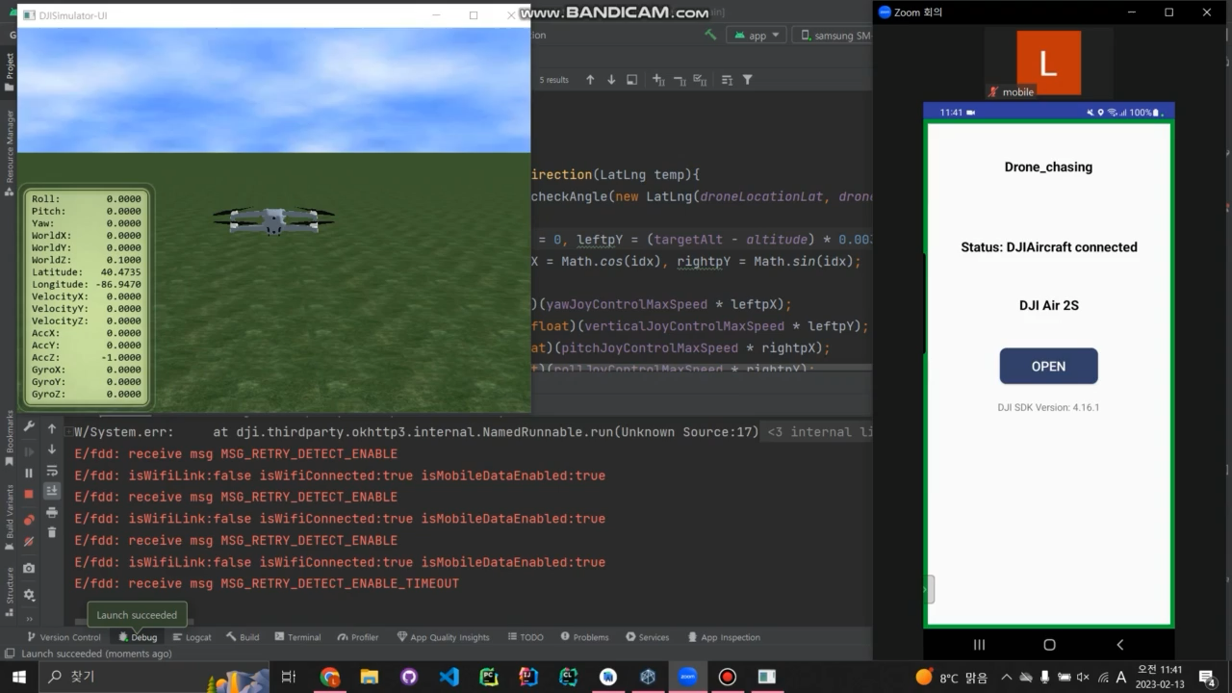
Demo

Slide 27
CONCLUSION
PROJECT CONCLUSION

Slide 28
Conclusion
Conclusion
This paper proposed an interface that uses a chasing algorithm with historical TSPI data
The experiments verify the trajectory prediction with ML models and implement the autopilot method
Future work is making the data communication connection between the devices and checking the latency

Slide 29
Thank You
Team. Beer per Day
Shinhyoung Jang, Byeonghwi Park, Juheon Jeong (Chungnam National University)
Jack Mahedy, Nebey Gebreslassie (Purdue University)

